Slide 1

David Moore’s Website
Author: David Moore
Date: 9/7/2024

Slide 2
LAMP Stack

Slide 3
LAMP STACK Information
Description:
The LAMP STACK, powerful open-source platform used to build dynamic and interactive web applications. Linux is the core operating system, Apache serves web content, MySQL or MariaDB handle database management, and PHP for processing server-side logic. This toolkit works seamlessly to create a flexible and scalable environment for web developers, providing all the essentials needed to run modern websites for both startups and large enterprises.
System Specs:
Operating System: Fedora Linux, 40 (Workstation Edition)
Apache Version: Apache, Version 2.4.62
Database: MariaDB, Version 10.11.8
PHP: PHP, Version 8.3.10

Slide 4
Index.php

Slide 5
Index.php Information
Description:
The index page, or homepage, is the primary gateway to the website, offering visitors a 1st glance into what the site is all about. Usually containing an introduction, key navigation links, and highlights on important sections to help users find relevant content quickly. The main purpose of an index page is to capture user attention, guide them through the site, and provide a clear sense of the website’s identity and structure.
Key Points about the Page:
Simple Design
Welcome Message and “About Me” section
Navigation Links

Slide 6
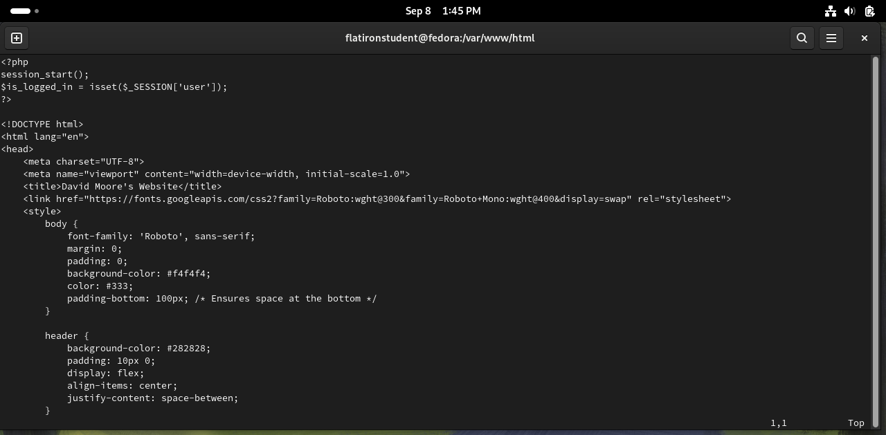
Index.php Code Screenshot
Session_start(); This initiates a PHP session and checks if a 'user' session is set, storing the result in $is_logged_in to determine whether the user is logged in or not.
Links to Google Fonts (Roboto and Roboto Mono), which are used for styling the text on the webpage.
The header is styled with a dark background color (#282828), and its content is aligned using flexbox to center items vertically and distribute them horizontally. Padding is added for spacing.

Slide 7
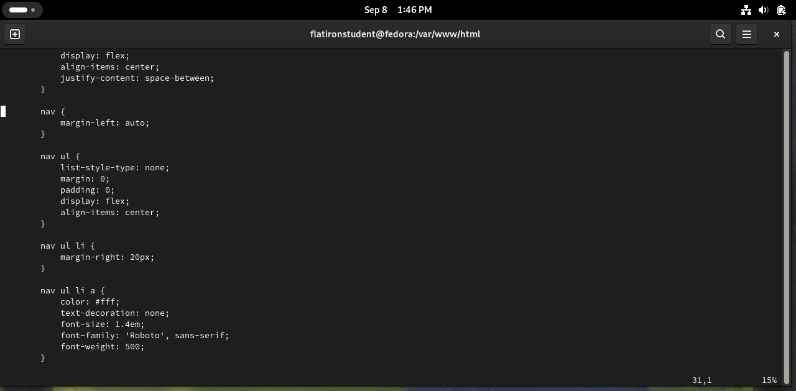
Index.php Code Screenshot
List Item (li) Styling: The list items (nav ul li) are spaced with margin-right: 20px, ensuring that each navigation link is spaced evenly from the next.
nav Element Styling: The navigation (nav) section is set to align to the right (margin-left: auto), pushing the navigation elements to the far right of the header.
Navigation List Styling (nav ul)
List Item (li) Styling
Navigation Link Styling (nav ul li a)

Slide 8
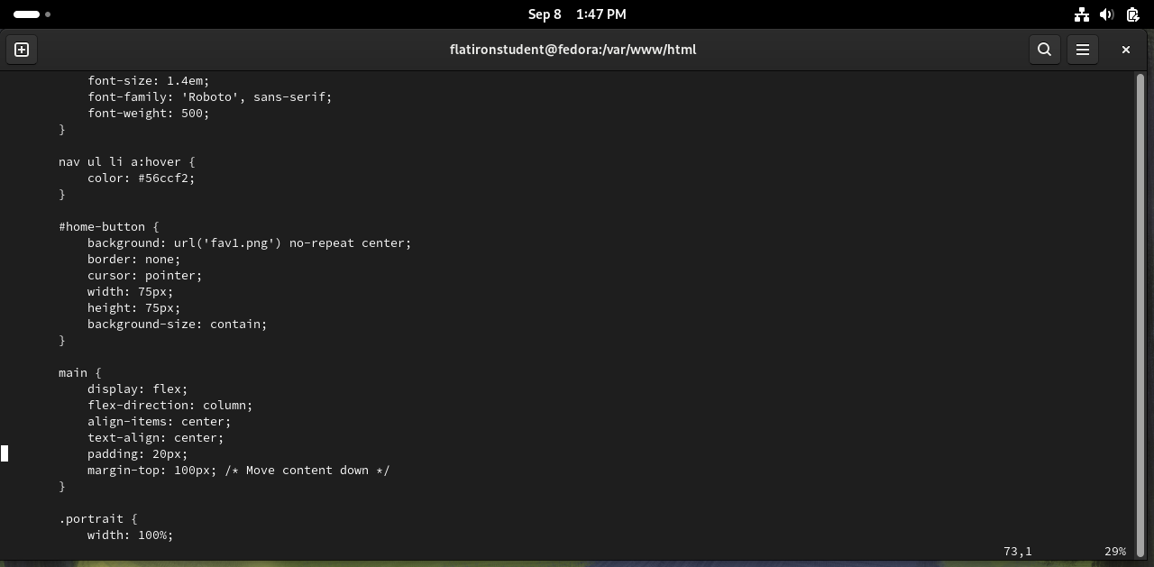
Index.php Code Screenshot
Hover Effect for Links (nav ul li a:hover)
Home Button Styling (#home-button)
Main Content Styling (main)
Portrait Image Styling (.portrait):

Slide 9
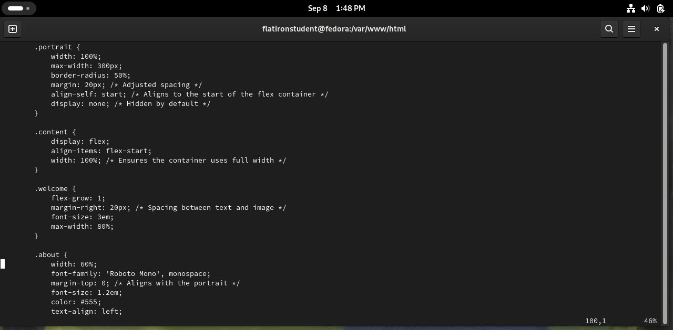
Index.php Code Screenshot
Portrait Styling (.portrait): The portrait image is set to a maximum width of 300px, with a circular shape (border-radius: 50%), and includes margins for spacing. It is aligned to the start of its flex container and is hidden by default (display: none).
Continued class styling for main homepage components.

Slide 10
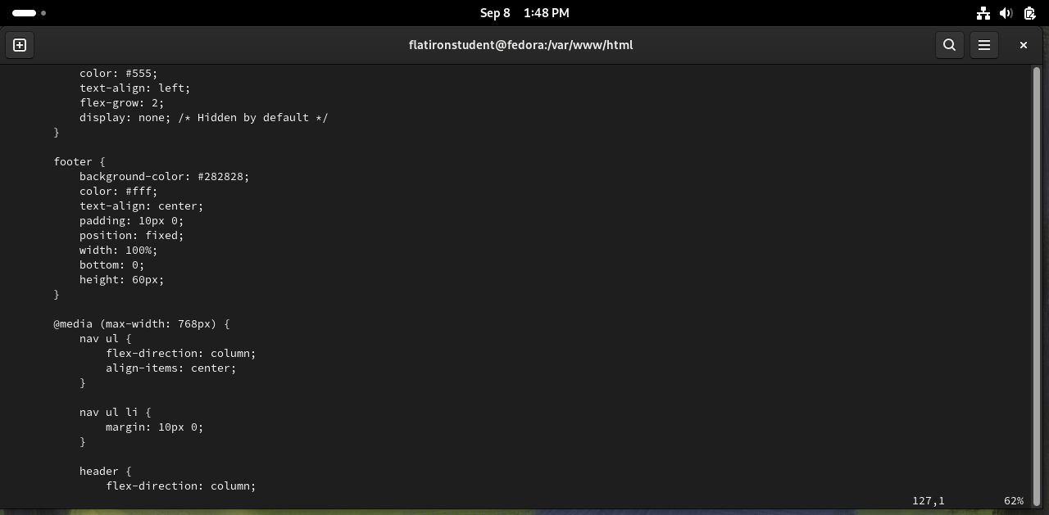
Index.php Code Screenshot
Footer Styling
Media Query for Responsive Design: This media query is activated when the screen width is 768px or smaller (@media (max-width: 768px)), adjusting the layout for smaller devices. It changes the navigation list (nav ul) to a vertical column layout (flex-direction: column) and centers its items.
Responsive List Item Styling (nav ul li)
Responsive Header Layout (header)

Slide 11
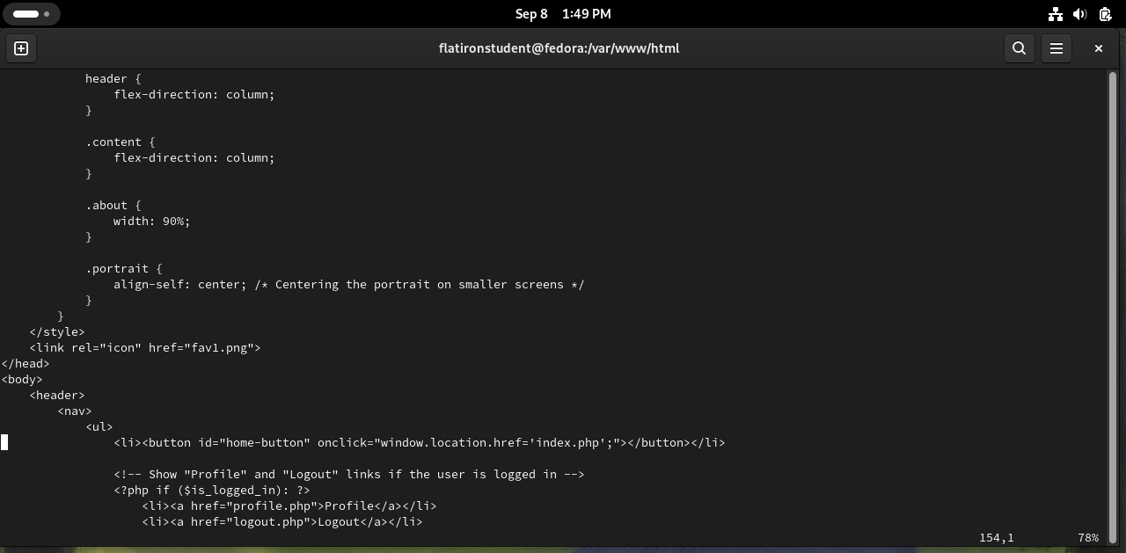
Index.php Code Screenshot
Styling for smaller screens continued.
Favicon Link: The <link> tag defines the favicon of the webpage, linking to the image fav1.png to display in the browser tab.
Home Button (#home-button): The home button is a clickable button that triggers a JavaScript onclick event, redirecting the user to the index.php page when clicked.
Conditional Profile and Logout Links: PHP conditional statements (<?php if ($is_logged_in): ?>) dynamically generate "Profile" and "Logout" links if the user is logged in, enhancing user experience based on session status.

Slide 12
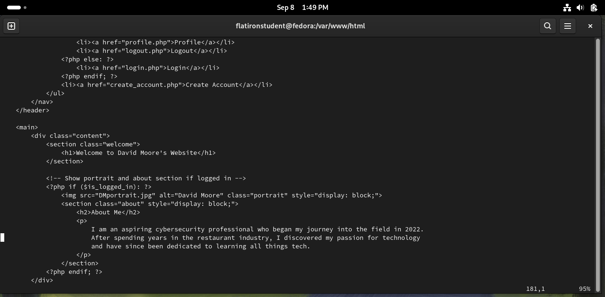
Index.php Code Screenshot
Profile and Logout Links: If the user is logged in, the "Profile" and "Logout" links are displayed, directing the user to their profile page and allowing them to log out.
Login Link: If the user is not logged in, the "Login" link is displayed, allowing the user to navigate to the login page.
Create Account Link: A "Create Account" link is always visible, directing new users to the account creation page.
Main Welcome Section: Inside the <main> tag, the welcome message ("Welcome to David Moore's Website") is prominently displayed inside the <h1> tag
Conditional Display of Portrait and About Section: If the user is logged in, their portrait image (DMportrait.jpg) is shown, along with an "About Me" section that provides a very brief “biography” of myself.

Slide 13
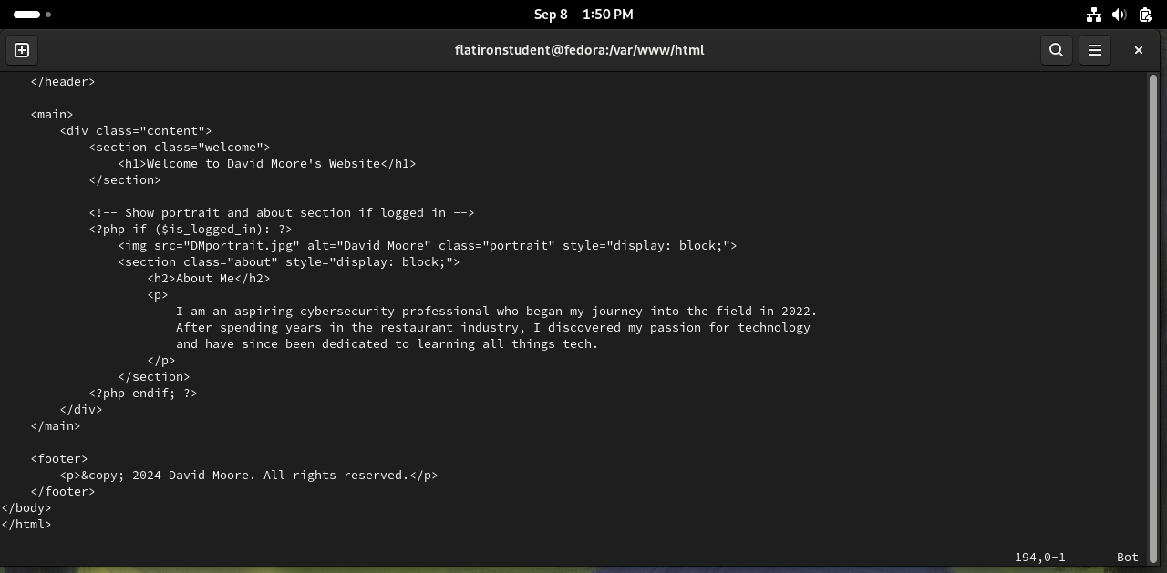
Index.php Code Screenshot
Main Content Wrapper (<div class="content">): This <div> serves as the container for the main content of the webpage, holding the welcome message and any additional content displayed to the user.
Footer Section (<footer>) Styling

Slide 14
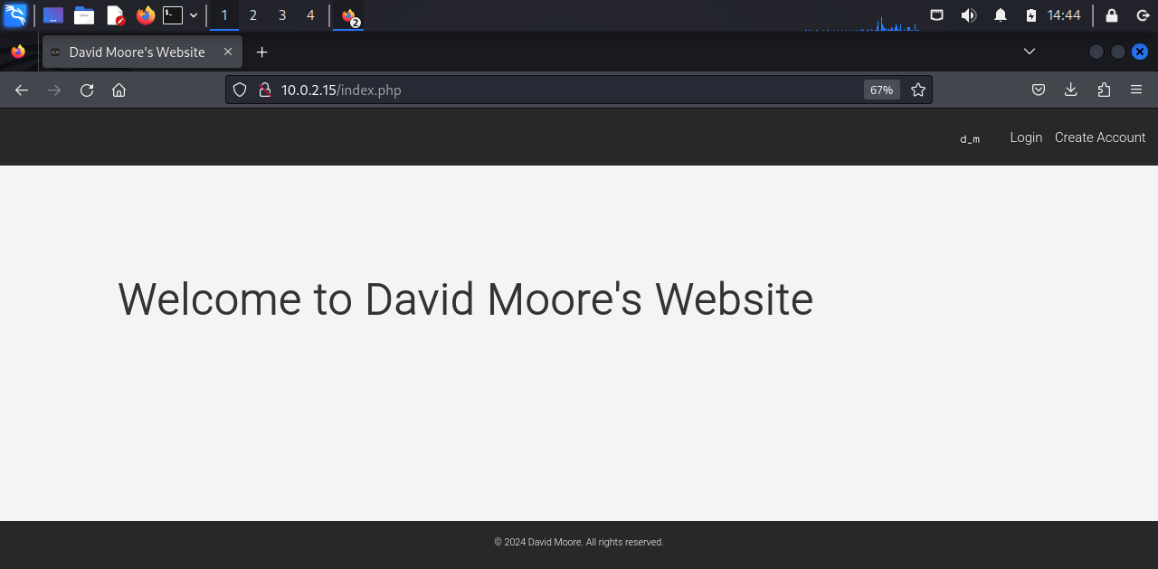
PHP Webpage Screenshot
Default display of index.php
Welcome Message
Header Bar with navigation links to “Login” and “Create Account”
Footer Bar with Copyright.

Slide 15
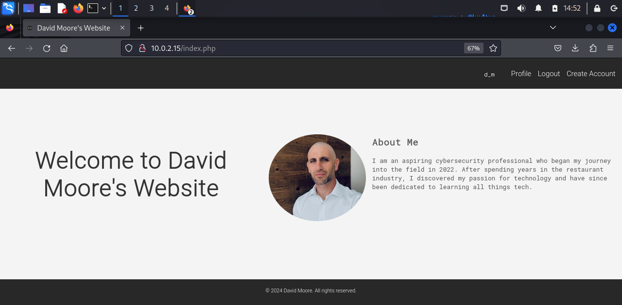
PHP Webpage Screenshot
Logged-in display of index.php
Welcome Message
Photo and “About Me” Section
Header Bar with navigation links to “Login” and “Create Account”, now includes the “Profile” link.
Footer Bar with Copyright.

Slide 16
Database Information

Slide 17
Database Information
Description:
The MariaDB database is important for my website because it helps store and manage user data, like account information and login details. By using MariaDB, my website can allow users to create accounts, log in, and access personalized content. It also helps make sure the data is stored securely, which is paramount in cybersecurity. Having a database like MariaDB makes it easier to manage and protect user information, while also making the website more flexible for future updates.
Key Points about the Page:
User Data Management: The MariaDB page is designed to store and manage user information securely, such as usernames, passwords (encrypted), and any other account-related data within the users table.
Data Retrieval and Interaction: The page integrates with MariaDB to handle dynamic queries, allowing the website to retrieve, update, or delete user data as needed.
Database Integration for Scalability: By using MariaDB, the page ensures that the website can scale efficiently with more users while maintaining data integrity and security, making it adaptable for future improvements and features.

Slide 18
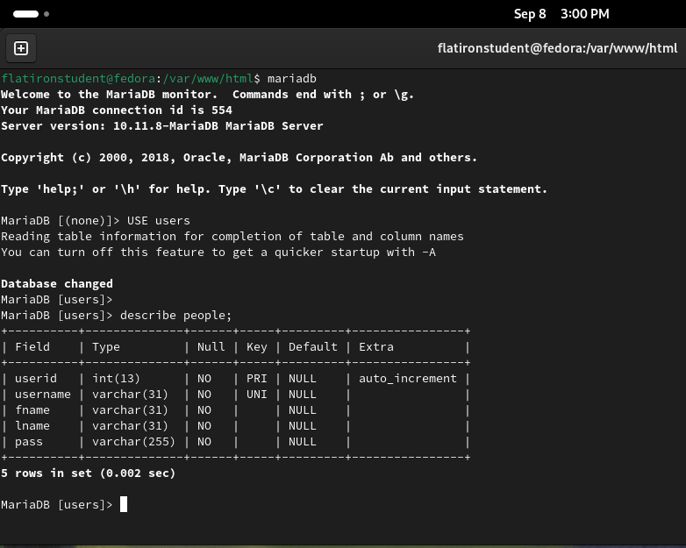
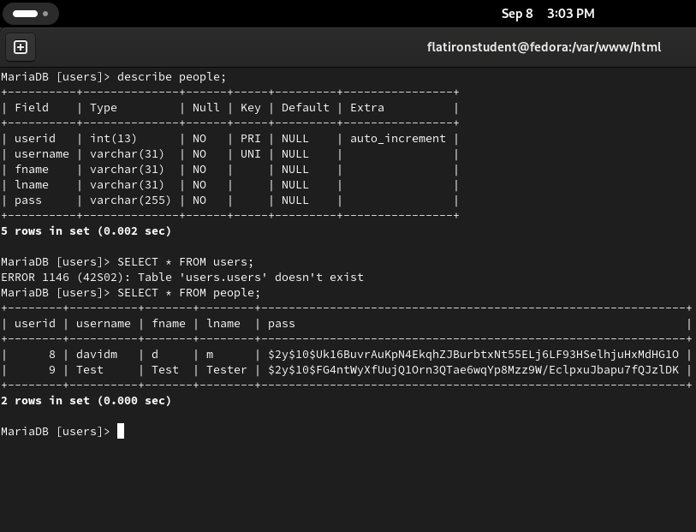
Database Screenshot

Slide 19
phptest.php

Slide 20
phptest.php Information
Description:
The purpose of a phptest.php page is to display important information about the PHP configuration on your server. When you access this page, it runs the phpinfo() function, which outputs details such as the PHP version, server environment, loaded extensions, and configuration settings. This page is typically used for troubleshooting and verifying that PHP is properly installed and configured, ensuring that your server can support the PHP-based functionality of your website.
Key Points about the Page:
Troubleshooting Tool: It serves as a useful tool for diagnosing server issues, ensuring that PHP is correctly installed and configured to support your website's functionality.
Server Environment Information: The page displays essential server environment details, including loaded modules and system paths, which can help in debugging and optimizing the website's performance.

Slide 21
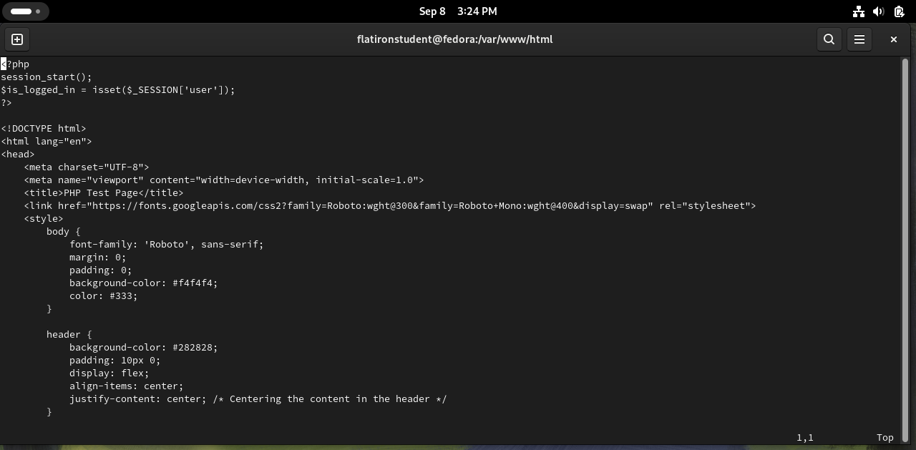
phptest.php Code Screenshot

Slide 22
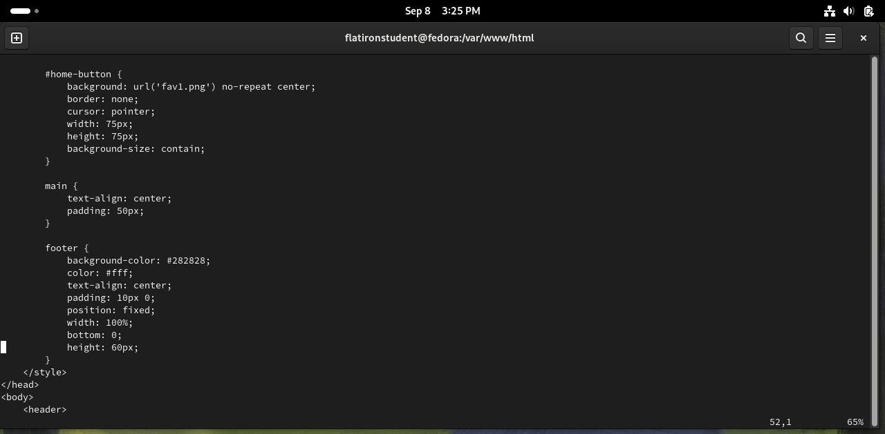
phptest.php Code Screenshot

Slide 23
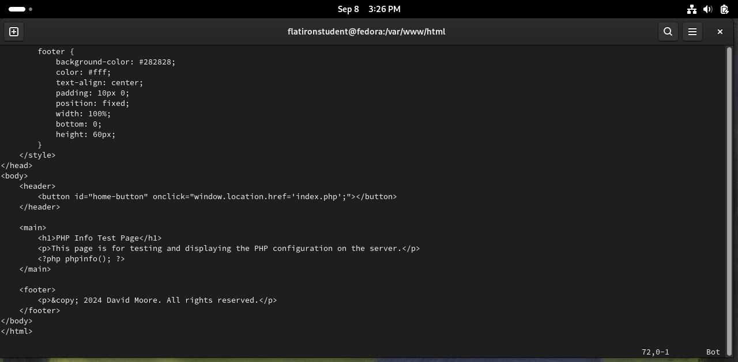
phptest.php Code Screenshot

Slide 24
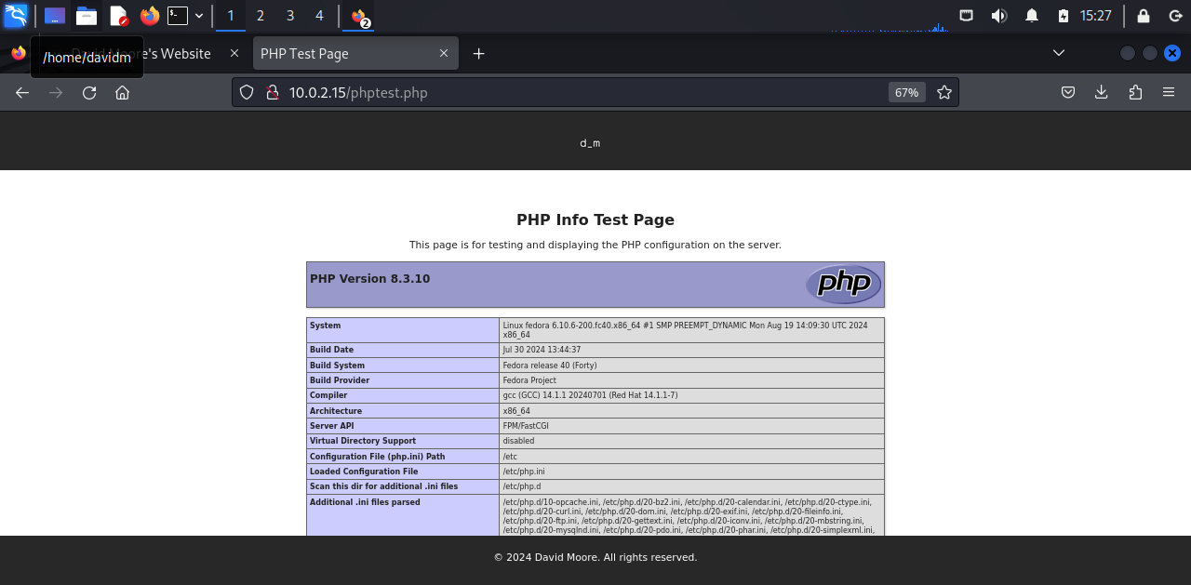
phptest.php Code Screenshot

Slide 25
Connect.php page

Slide 26
Connect Page Information
Description:
The connect.php page is designed to establish a secure connection to a MariaDB or MySQL database. It defines the necessary credentials such as the server name, database name, username, and password, and then uses PHP Data Objects (PDO) to connect to the database. The page also includes error handling to catch and display connection errors if the connection fails. This setup is important because it allows the website to interact with the database securely and efficiently, enabling features like user authentication or data retrieval.
Key Points about the Page:
Error Handling: It includes robust error handling through PDOException, ensuring that any issues during the connection process are caught and can be addressed appropriately.
Credential Storage: The page stores the server name, database name, username, and password in variables, which are then used to authenticate the connection, allowing the website to communicate with the database.

Slide 27
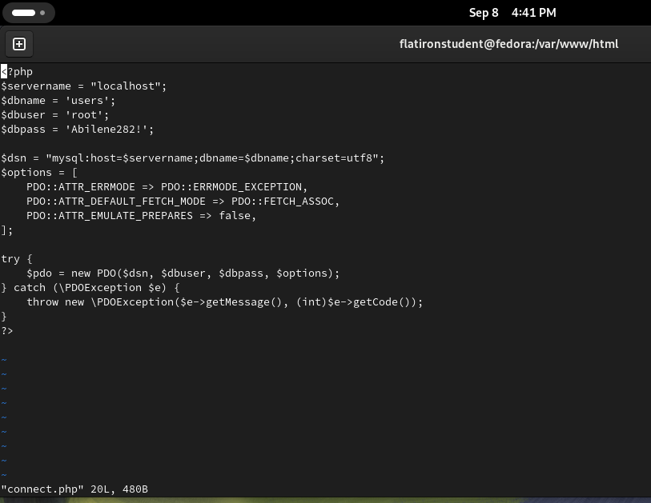
PHP Code Screenshot
Variables Initialization. Several variables are initialized to store the database connection parameters.
The $dsn variable defines the Data Source Name, which contains the information required to connect to the database.
Connection Options ($options)
Try-Catch Block for Connection Handling

Slide 28
Account Creation Web Page

Slide 29
Account Creation Page Information
Description:
The create_account.php page allows users to create a new account by submitting their username, first name, last name, and password through a form. It includes security features such as CSRF token validation to protect against cross-site request forgery and hashes passwords for secure storage. After successfully creating an account, users are redirected to the login page.
Key Points about the Page:
Account Creation Form
Security Features: It implements security measures like CSRF token validation and password hashing to protect user data and prevent unauthorized submissions.
Database Integration: The page interacts with the database, inserting new user information into the people table upon successful form submission.

Slide 30
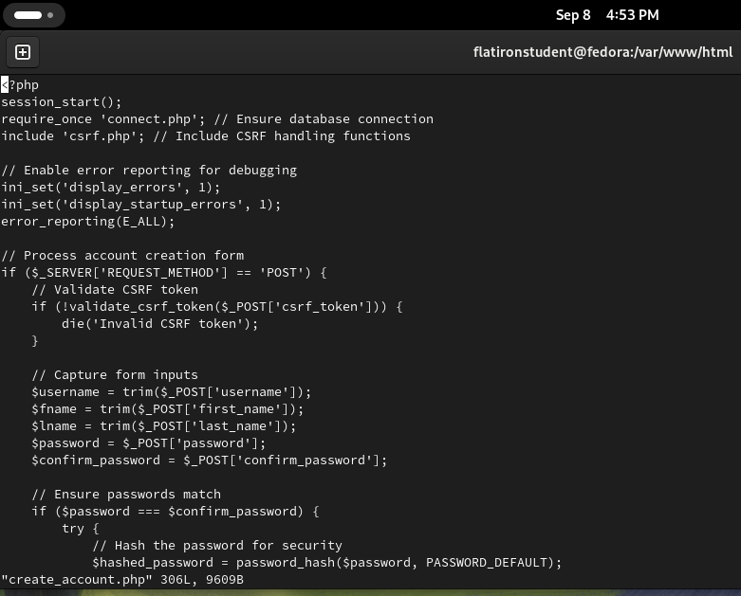
PHP Code Screenshot
The code starts by initiating a session with session_start() and including necessary files like connect.php for database connection and csrf.php for CSRF protection. It enables error reporting for debugging, then checks if the form has been submitted using the POST method. Upon submission, it validates the CSRF token to ensure the request is legitimate. User inputs such as username, first name, last name, and password are captured and sanitized. It verifies that the password and confirmation match, and if so, the password is securely hashed using password_hash() before being stored in the database.

Slide 31
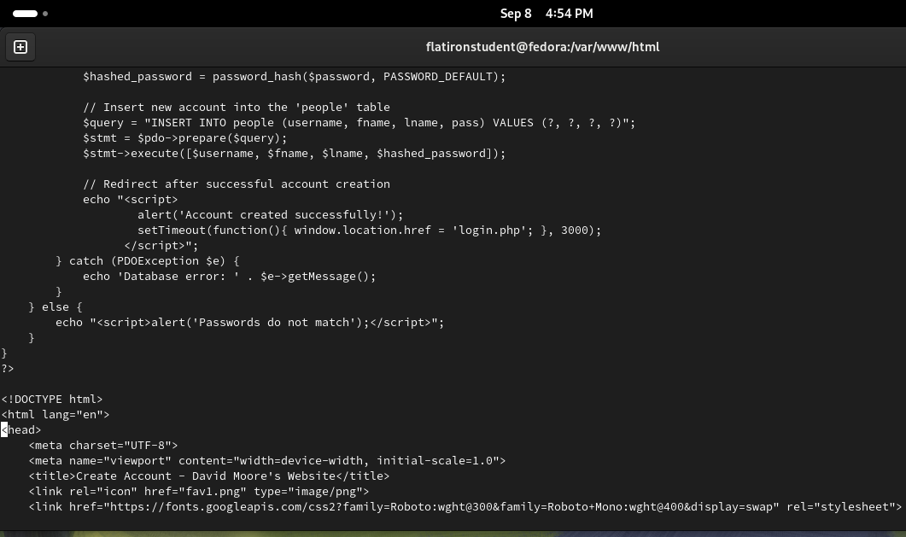
PHP Code Screenshot
Password Hashing ($hashed_password = password_hash())
SQL Query Preparation and Execution ($stmt = $pdo->prepare($query);)
Success Redirection and Alert (echo "<script>...)
Error Handling (catch (PDOException $e))
Password Mismatch Alert (else { echo "<script>alert(...)

Slide 32
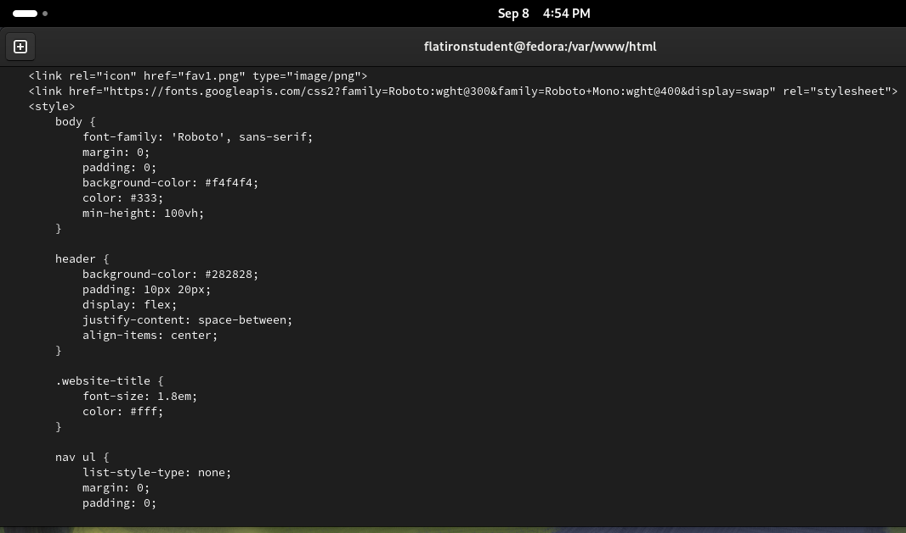
PHP Code Screenshot
body Styling
header Styling
.website-title Class
nav ul Styling

Slide 33
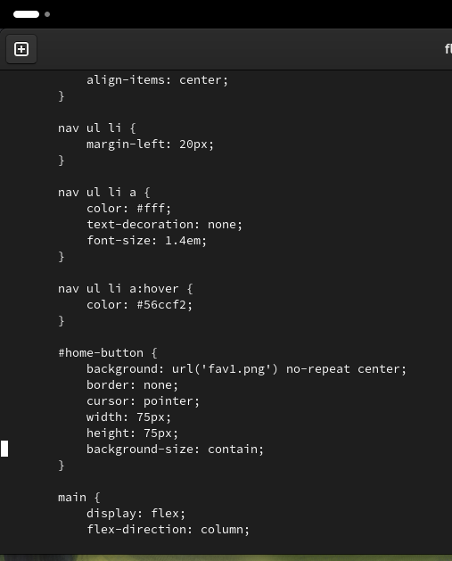
PHP Code Screenshot
nav ul li Styling
nav ul li a Styling
nav ul li a:hover Styling
#home-button Styling
main Styling

Slide 34
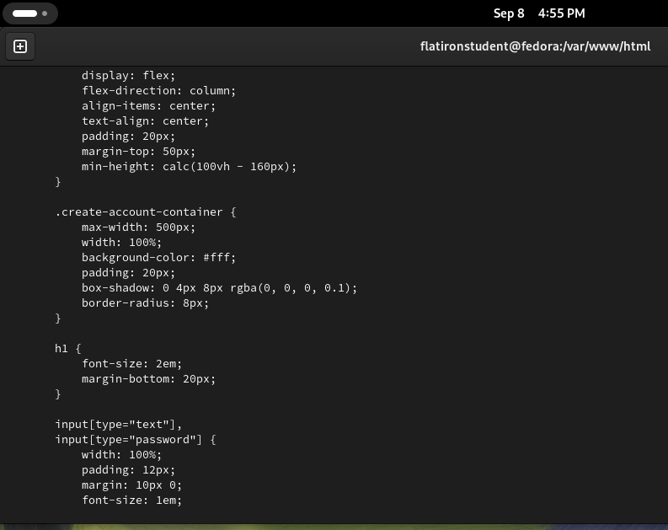
PHP Code Screenshot
.create-account-container Styling
h1 Styling
Input Fields Styling (input[type="text"], input[type="password"])

Slide 35
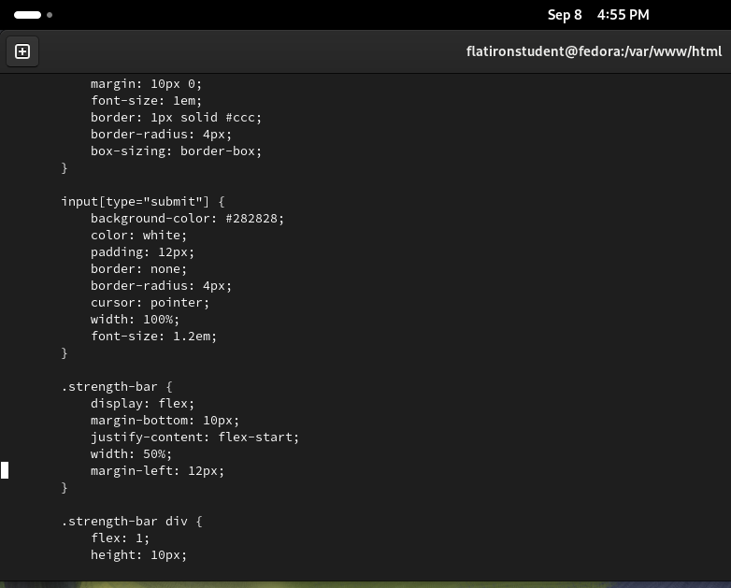
PHP Code Screenshot
Input Fields (input[type="text"]) Styling
Submit Button (input[type="submit"]) Styling
Password Strength Bar (.strength-bar) Styling
Password Strength Bar Divs (.strength-bar div)

Slide 36
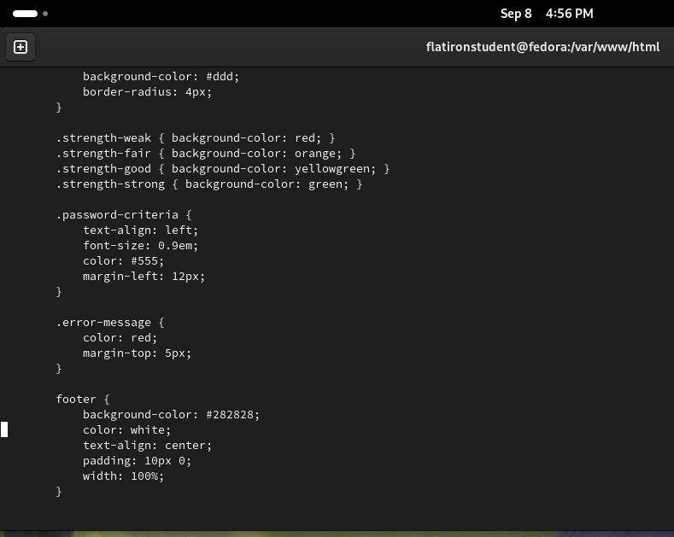
PHP Code Screenshot
Password Strength Indicators (.strength-weak, .strength-fair, .strength-good, .strength-strong)Each class changes the background color of the password strength bar based on the strength of the password, ranging from red (weak) to green (strong).
Password Criteria (.password-criteria)Styles the password criteria section with left-aligned text, smaller font size (0.9em), and a light color to guide users on password requirements.
Error Message (.error-message)Styles error messages with a red color and a small top margin to clearly indicate validation issues to the user.
Footer Styling

Slide 37
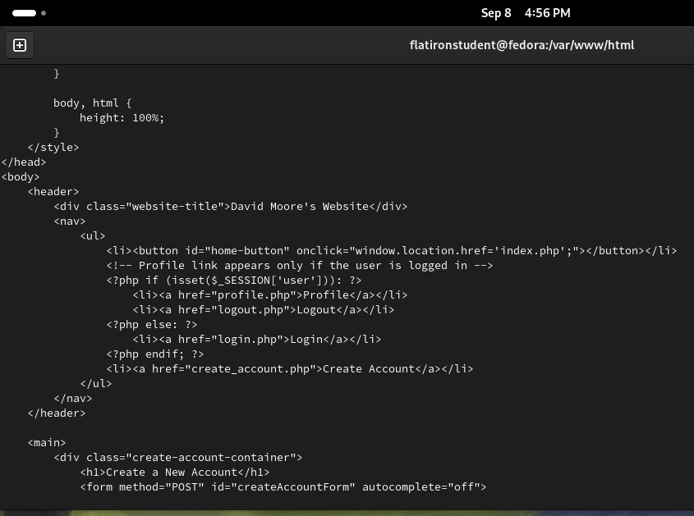
PHP Code Screenshot
PHP Session Check (<?php if (isset($_SESSION['user'])): ?>)Checks if a user session is active (i.e., the user is logged in), and if so, displays the "Profile" and "Logout" links.
Conditional Links (<?php else: ?>)If the user is not logged in, it shows the "Login" link instead of "Profile" and "Logout.“
Navigation List (<ul><li>)Provides a navigation menu with options like "Profile," "Login," "Logout," and "Create Account," depending on the user's session status.

Slide 38
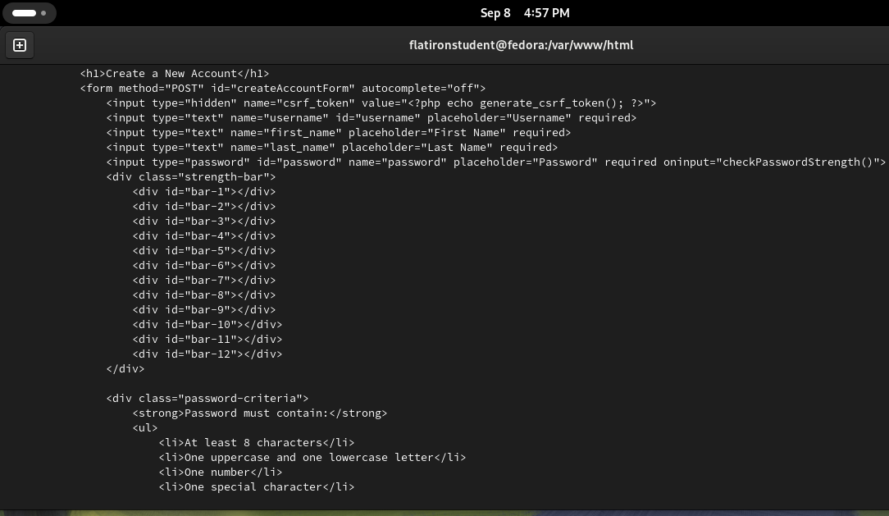
PHP Code Screenshot
Text Input Fields
Password Input Field (<input type="password" ...>)A password input field that triggers the checkPasswordStrength() function to dynamically evaluate the strength of the entered password, with the required attribute to ensure the field is completed.
Strength Bar (<div class="strength-bar">)A visual strength bar consisting of multiple divs that update in color based on the password strength, providing real-time feedback to the user.
Password Criteria (<div class="password-criteria">)Displays a list of password requirements (e.g., minimum length, character types) to guide users in creating a secure password.

Slide 39
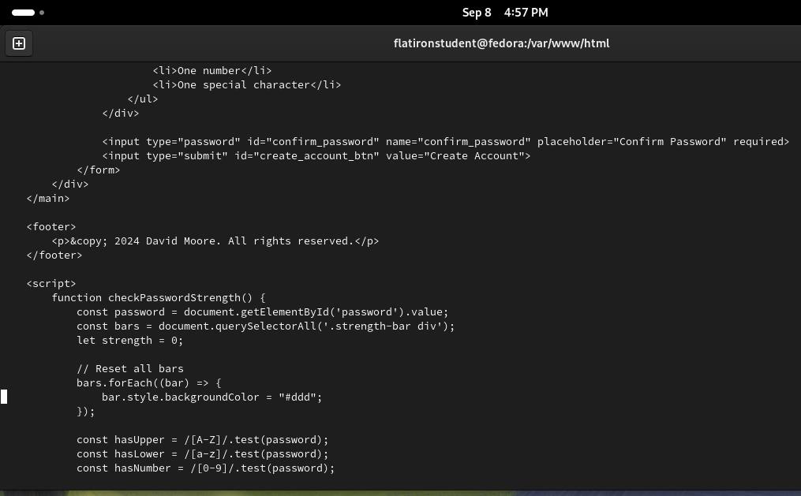
PHP Code Screenshot
Password Confirmation Field
Submit Button
Footer
checkPasswordStrength() JavaScript Function
Password Strength Bar ResetResets the background color of all strength bar divs to a neutral color (#ddd) each time the password changes, ensuring the strength indicator is updated in real-time.

Slide 40
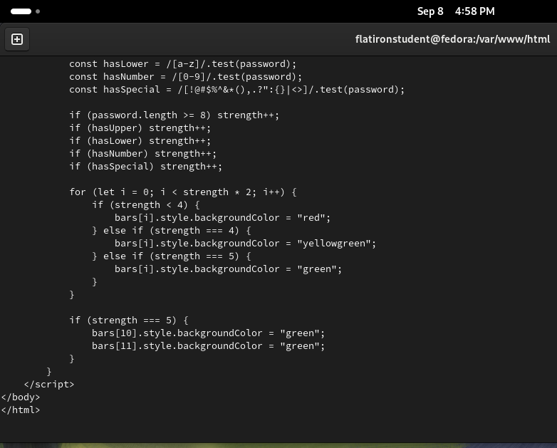
PHP Code Screenshot
Password Criteria Checks (const hasUpper, hasLower, hasNumber, hasSpecial)
Password Strength CalculationThe strength of the password is determined by incrementing the strength variable based on whether the password meets certain criteria (length, upper/lower case, numbers, special characters).
Strength Bar Color Update (Loop)A loop iterates over the strength bar divs and updates their color: red for weak passwords, yellow-green for moderate strength, and green for strong passwords.
Additional Green Bars for Strong PasswordsIf the password achieves the highest strength score (5), two additional bars in the strength bar are colored green, signaling a very strong password.

Slide 41
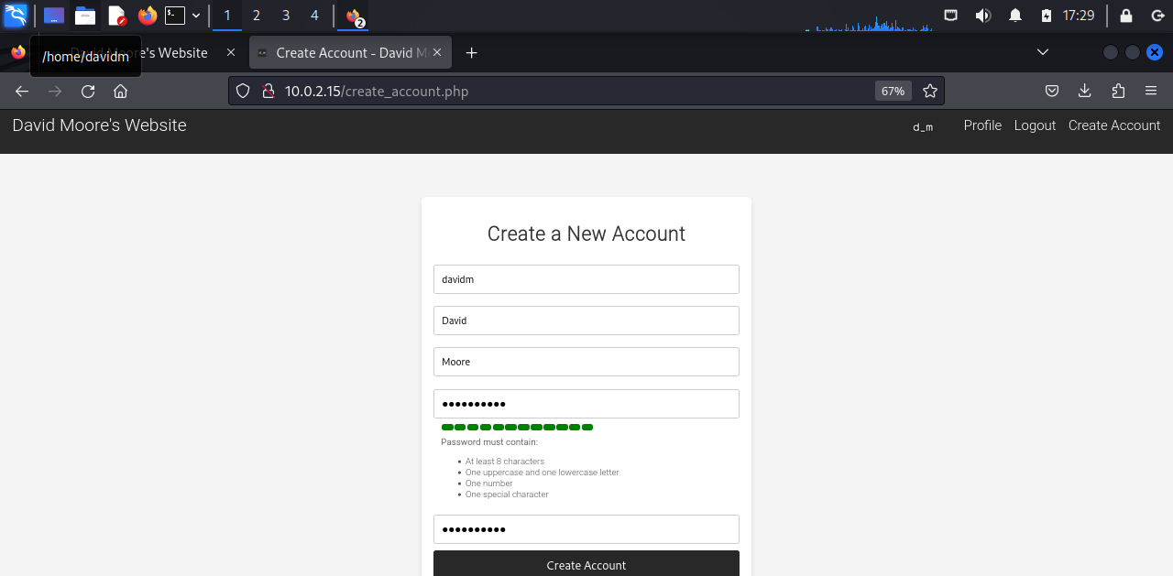
PHP Webpage Screenshot
Header
Account Creation Form
Password Strength Bar
Password Criteria
Submit Button

Slide 42
Login Webpage

Slide 43
Login Page Information
Description:
The login.php page is used to let users log in to the website by entering their username and password. It has some security features like a CSRF token to make sure the form submission is safe and checks the password against what’s stored in the database. If the user is already logged in, the page will automatically take them to their profile. If the username or password is wrong, an error message will show up. This page helps keep user accounts secure while letting them access their profiles.
Key Points about the Page:
User Authentication
Security Measures
Error Handling

Slide 44
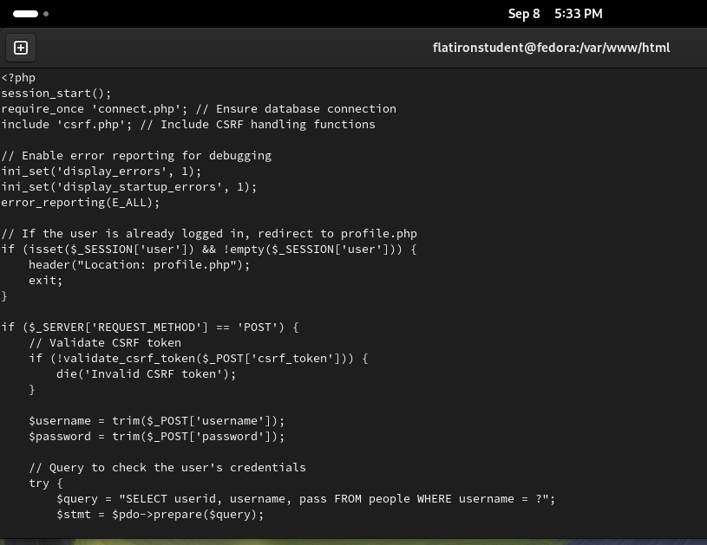
PHP Code Screenshot
Error Reporting Configuration (ini_set() and error_reporting())
Session Check and Redirect (if (isset($_SESSION['user'])))Checks if a user is already logged in by verifying the session and redirects them to the profile page if true.
Form Submission Handling (if ($_SERVER['REQUEST_METHOD'] == 'POST'))Handles the login form submission and processes user credentials for authentication if the form is submitted via POST.
CSRF Token Validation
User Input Capture ($username and $password)
Database Query for CredentialsPrepares and executes a query to check the entered username in the database, ensuring the user’s credentials are valid.

Slide 45
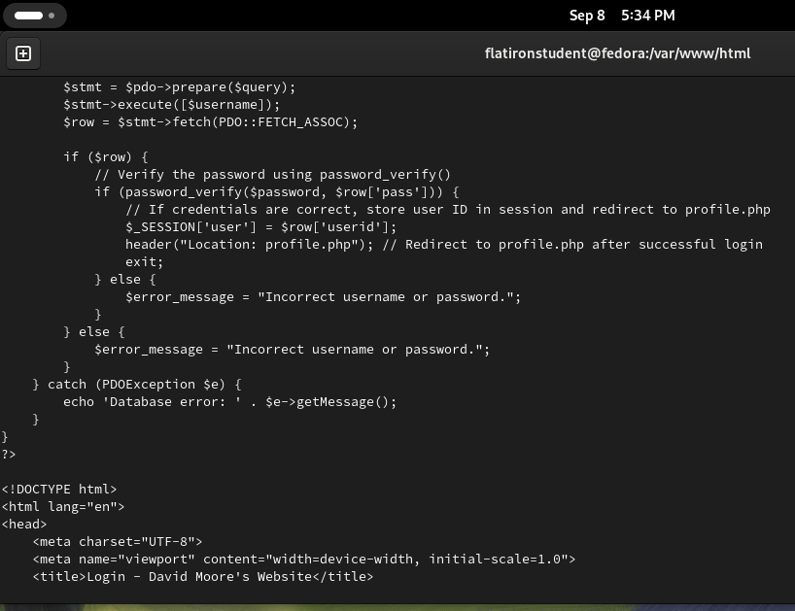
PHP Code Screenshot
Database Query Execution ($stmt->execute([$username]);)
Fetch User Data ($row = $stmt->fetch(PDO::FETCH_ASSOC);)
Password Verification (if (password_verify($password, $row['pass'])))
Session Setup and Redirection ($_SESSION['user'] = $row['userid’];)
Error Handling ($error_message = "Incorrect username or password.")
Exception Handling (catch (PDOException $e))

Slide 46
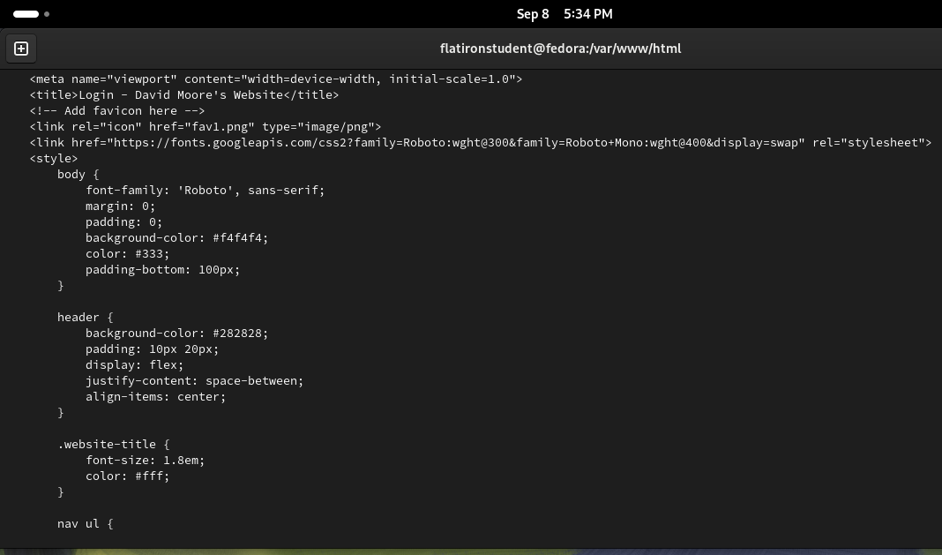
PHP Code Screenshot
Meta Viewport Tag (<meta name="viewport">)Ensures the page is responsive by setting the viewport width to match the device’s width and scaling it properly for mobile devices.
Favicon (<link rel="icon">)
Body Styling
Header Styling
Website Title Styling
Navigation List Styling

Slide 47
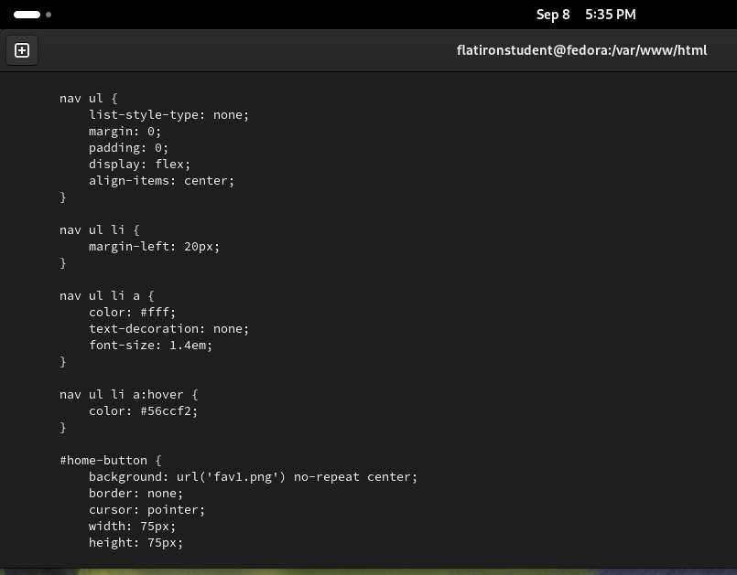
PHP Code Screenshot
Nav link Styling
Home Button Styling

Slide 48
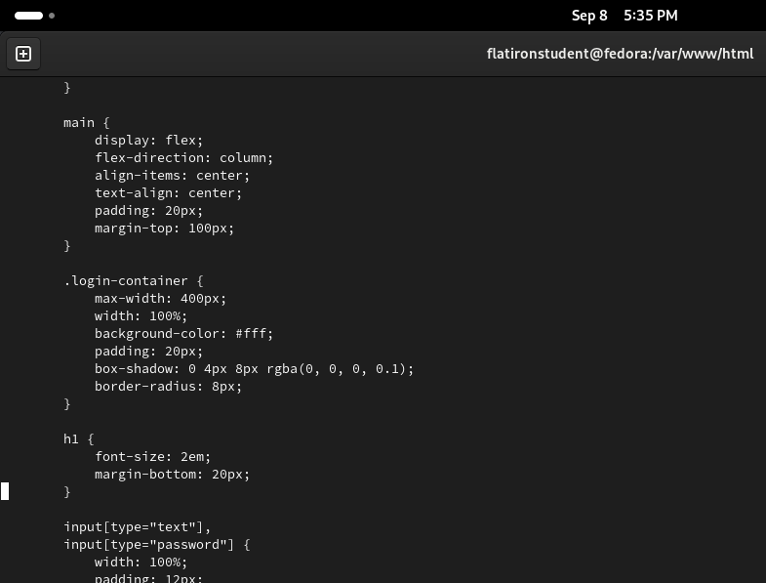
PHP Code Screenshot
Class Styling continued

Slide 49
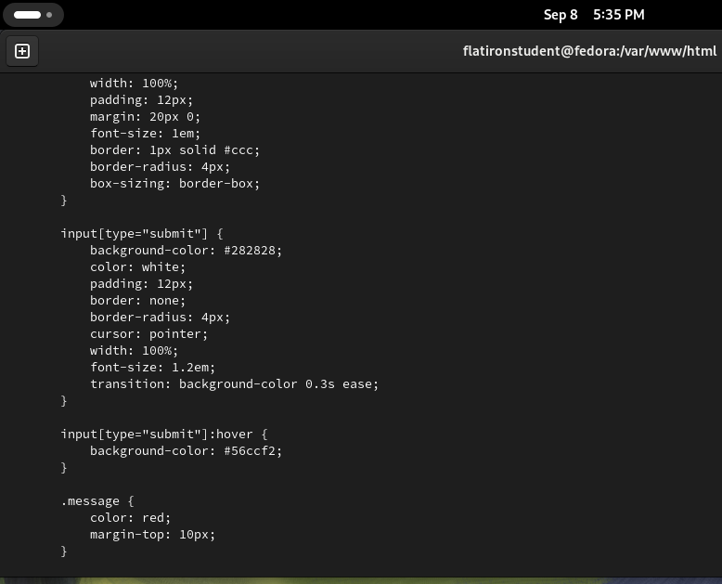
PHP Code Screenshot
Text Input Fields Styling
Submit Button Styling
Submit Button Hover Effect
Error Message Styling

Slide 50
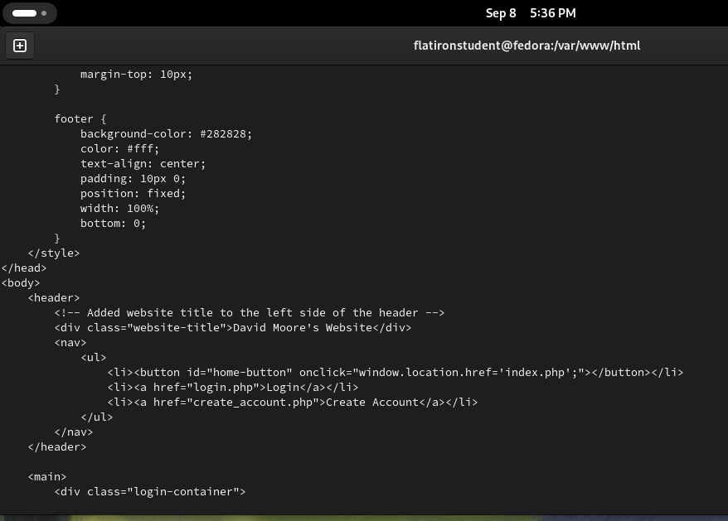
PHP Code Screenshot
Website Title
Navigation Menu
Home Button
Login Container (<div class="login-container">)A container that holds the login form elements, styled for a clean and organized appearance.

Slide 51
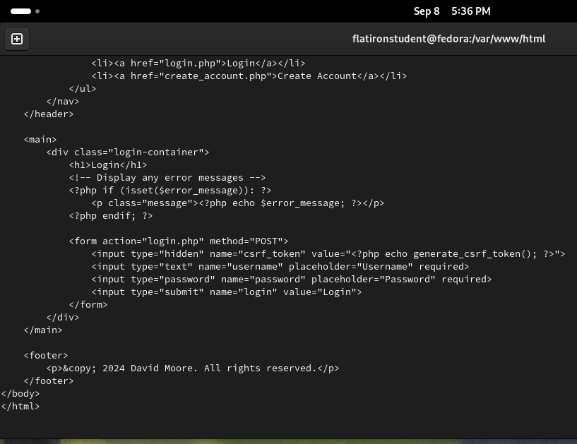
PHP Code Screenshot
Error Message Handling (<?php if (isset($error_message)): ?>)
Login Form (<form action="login.php" method="POST">)
CSRF Token (<input type="hidden" name="csrf_token" ...>)
Input Fields for Username and Password
Submit Button

Slide 52
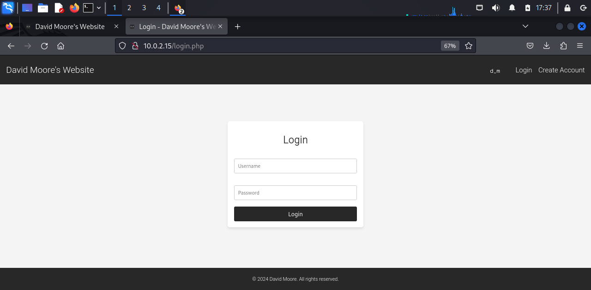
PHP Webpage Screenshot
Login container with input fields
Header Bar with navigation links to keep the display uniform with the other pages

Slide 53
Profile.php page

Slide 54
Profile Page Information
Description:
The profile.php page displays a user's profile information after they have logged in. It checks if a user session exists, and if not, redirects them to the login page. Once verified, the page retrieves and displays the user's first name, last name, and username from the database. The purpose of the page is to provide users with a personalized view of their profile and allow them to log out or navigate back to the homepage. Additionally, it includes security features like session regeneration to protect the user's session.
Key Points about the Page:
User Authentication: The page checks if a user is logged in by verifying the session, and redirects to the login page if no session exists.
Profile Information Display: It retrieves and displays the logged-in user's profile details, such as their username, first name, and last name, from the database.
Security Measures: The page includes session security by regenerating the session ID upon loading to prevent session hijacking.

Slide 55
PHP Code Screenshot
Session Check (if (!isset($_SESSION['user']))), checks if a user session exists; if not, the user is redirected to the login page to prevent unauthorized access.
Session Regeneration (session_regenerate_id(true);), regenerates the session ID to provide additional security by mitigating session fixation attacks.
Fetching User Profile Information, prepares and executes an SQL query to fetch the logged-in user's profile information (username, first name, and last name) from the database using their session ID.
User Validation (if (!$userRow)), if no user data is found in the database, the user is logged out, which helps handle cases where the user session might be invalid.

Slide 56
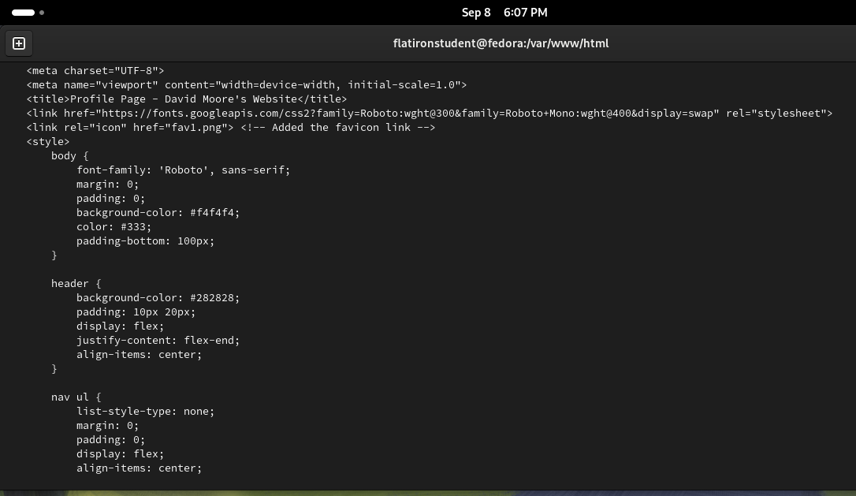
PHP Code Screenshot
Meta Viewport Tag to ensure responsiveness
CSS continued

Slide 57
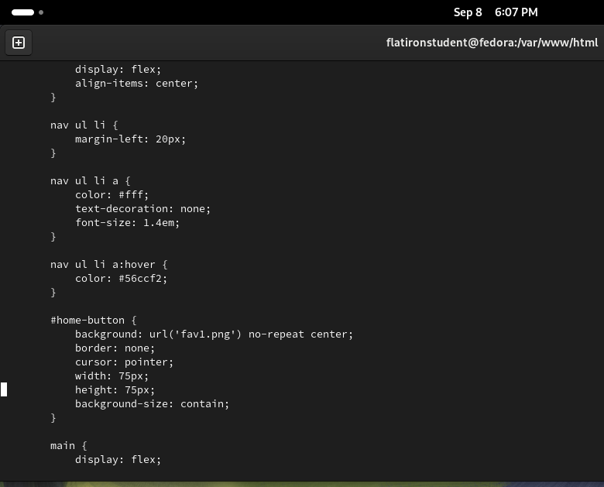
PHP Code Screenshot
Navigation Styling
Home Button Styling
Main Section Styling

Slide 58
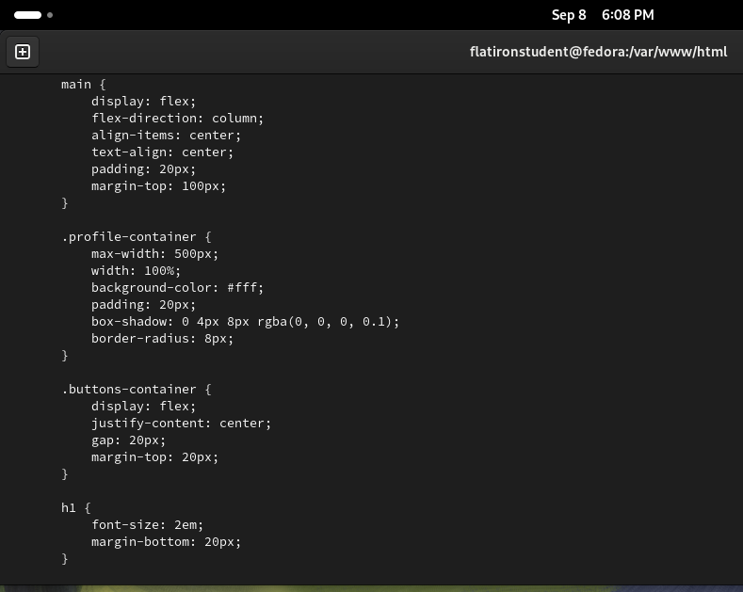
PHP Code Screenshot
Profile Container Styling
Buttons Container Styling
Heading Styling

Slide 59
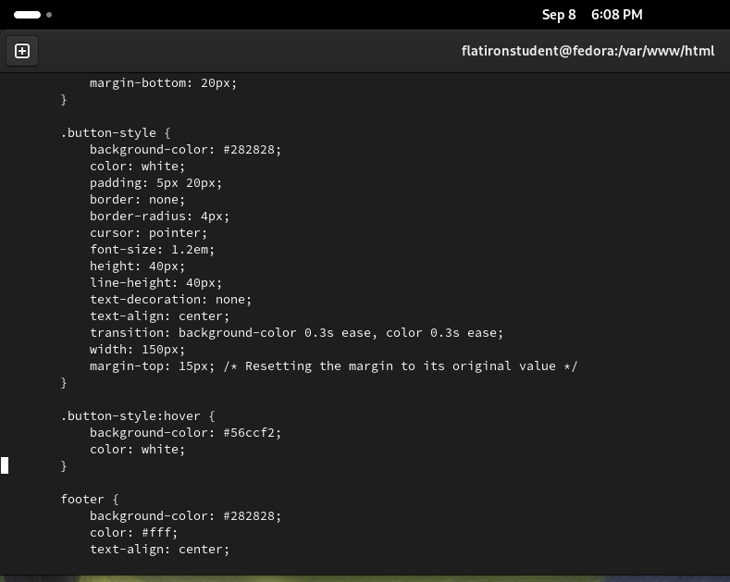
PHP Code Screenshot
Button Styling
Footer Styling

Slide 60
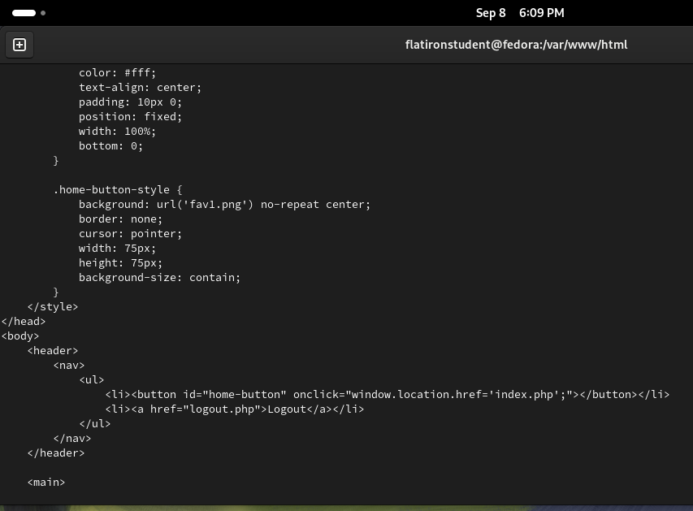
PHP Code Screenshot
Home Button Styling
Logout Link (<a href="logout.php">Logout</a>), A clickable link that allows the user to log out of their account, ensuring easy navigation and session management.

Slide 61
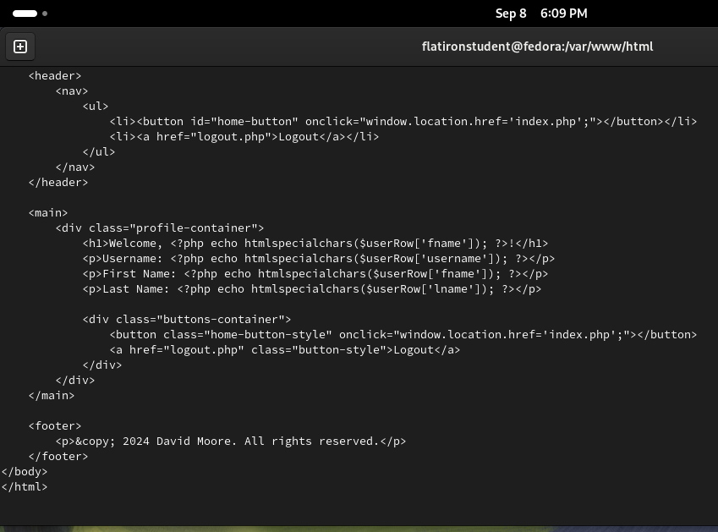
PHP Code Screenshot
Header and Navigation
Profile Container
Greeting Heading (<h1>Welcome, <?php echo htmlspecialchars($userRow['fname']); ?>, outputs a personalized greeting with the user's first name, securely rendering the value to prevent XSS attacks using htmlspecialchars()
User Information Display
Buttons Container
Footer

Slide 62
Logout.php page

Slide 63
Logout Page Information
Description:
The logout.php page is responsible for securely logging the user out of their session. It begins by starting the session to ensure session data is accessible, then destroys all session data using session_destroy(). After clearing the session, it redirects the user to the login page (login.php) to allow them to log back in or remain logged out. This script ensures that all user data is properly cleared, and the user is redirected to a secure state after logging out.
Key Points about the Page:
Session Termination: The page uses session_destroy() to completely terminate the user's session, ensuring all session data is removed.
Redirection to Login: After destroying the session, the user is immediately redirected to the login page, guiding them to a secure login state.
Security: The page ensures that once the session is destroyed, the script execution stops, preventing any further actions after logging out.

Slide 64
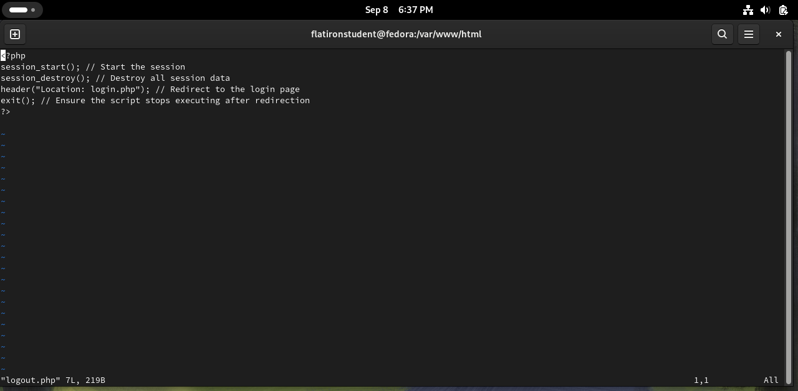
PHP Code Screenshot
session_start(); Initiates or resumes the current session, ensuring session data is accessible before proceeding with the logout process.
session_unset(); Unsets all session variables, clearing any data stored in the session without destroying the session itself.
session_destroy(); Destroys the session, completely removing any session data, and ending the session for the user.
header('Location: login.php’); Redirects the user to the login page after the session is destroyed, ensuring they cannot access restricted pages without logging back in.
exit();Stops the script execution immediately after the redirection to ensure no further code is run after the session is destroyed.

Slide 65
404 Error Page

Slide 66
404 Error Page Page Information
Description:
The 404.php page is a custom error page designed to handle "Page Not Found" (404) errors when users try to access a page that doesn't exist. It displays a clear "Error 404" message and provides a link for users to return to the homepage. The page is styled with a clean and simple design, using a light background and a red error message to signal the issue. The purpose of the page is to guide users back to the main site gracefully when they encounter an error, rather than displaying a generic server error message.
Key Points about the Page:
Error Handling
User Navigation
Simple and Clean Design

Slide 67
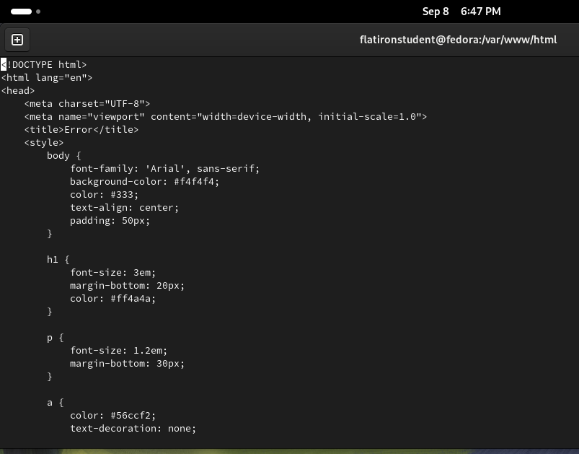
PHP Code Screenshot
Meta Viewport Tag
Title Tag
Body Styling
Heading
Paragraph Styling
Link Styling

Slide 68
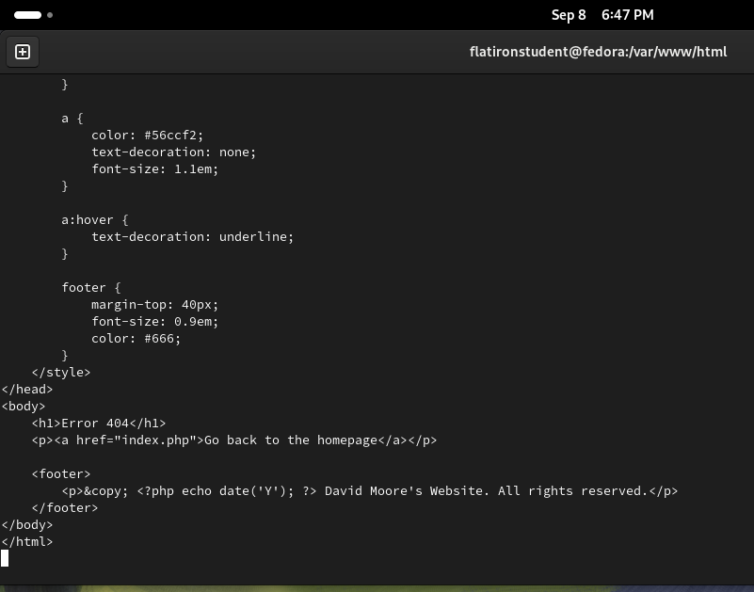
PHP Code Screenshot
Link
Link Hover Effect
Footer Styling
Error Message (<h1>Error 404</h1>), Displays a large, bold "Error 404" message at the top of the page, making it clear that the requested page was not found.
Back to Homepage Link (<a href="index.php">...), Provides a clickable link that redirects the user back to the homepage, allowing them to navigate away from the error page.
Dynamic Copyright in Footer (<?php echo date('Y'); ?>)

Slide 69
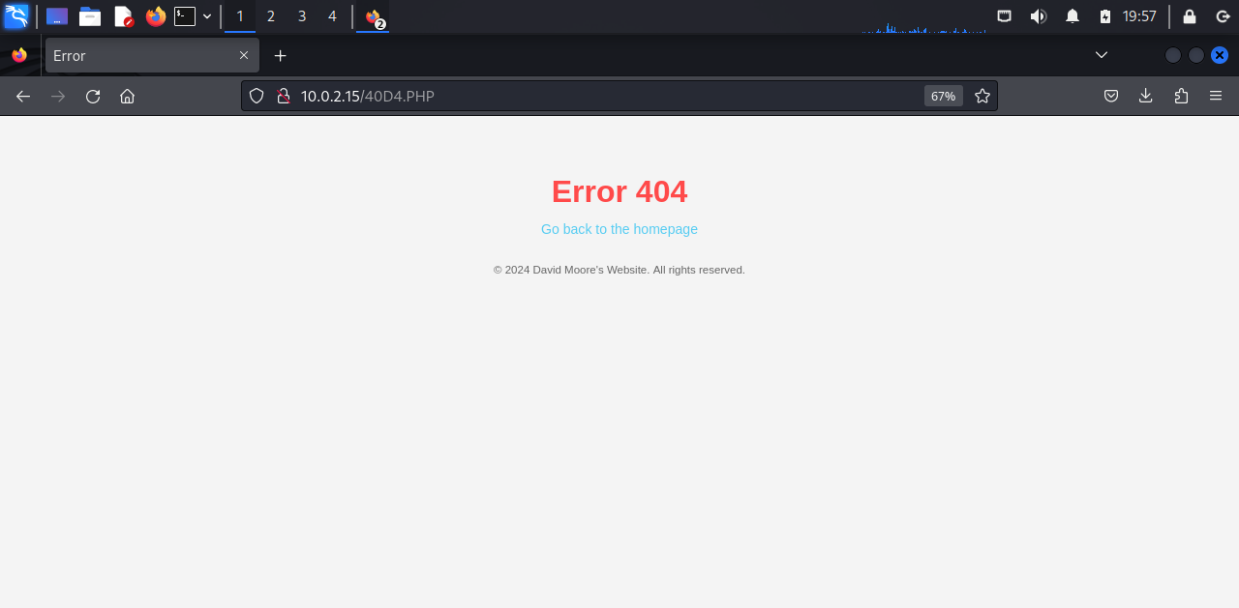
PHP Webpage Screenshot
Error message
Link back to homepage

